Slide 1


Indexing e-Journal
aji.prasetya.ft@um.ac.id

Slide 2
Agenda
Background Indeksasi Jurnal
Jenis pengindeks
Mengindekskan e-jurnal di beberapa mesin pengindeks: googlescholar, doaj, scopus

Slide 3
Indeks memudahkan
  aggregators & libraries: mengintegrasi jurnal terindeks dengan layanannya
  Publishers: menguatkan posisi jurnal
  Readers: mencari artikel sebagai referensi
  Authors: mencari jurnal yang tepat publikasi + meningkatkan ketenaran

Slide 4
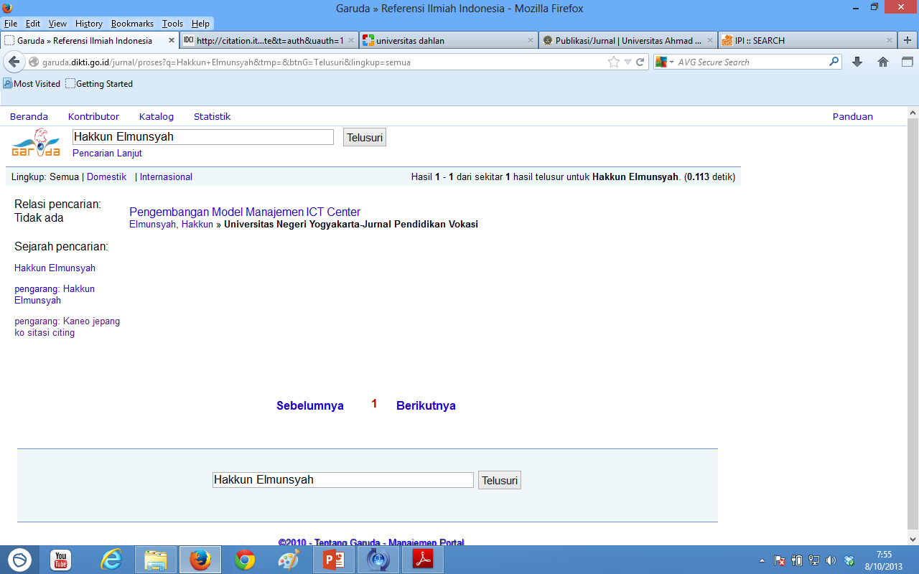
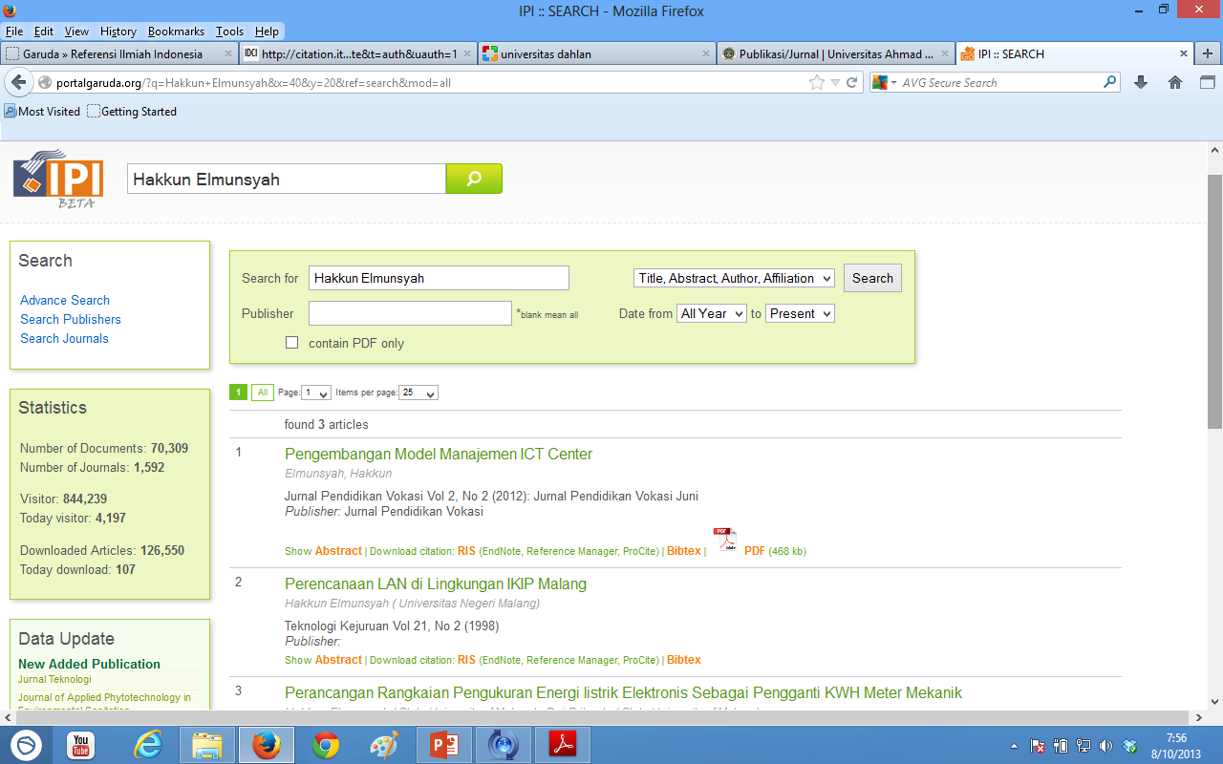
Contoh Hasil Pencarian di Situs Pengindex

Slide 5
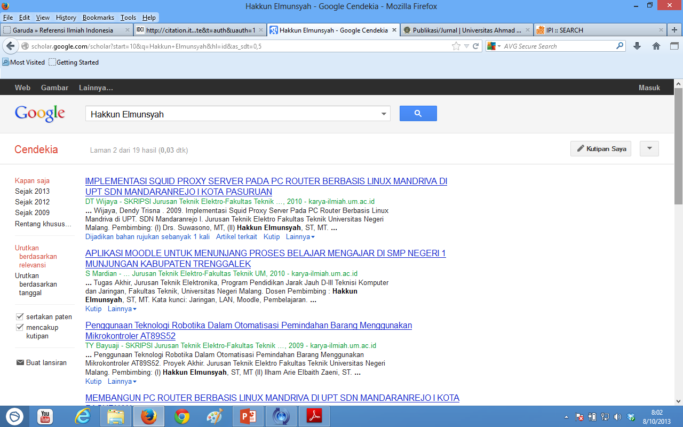
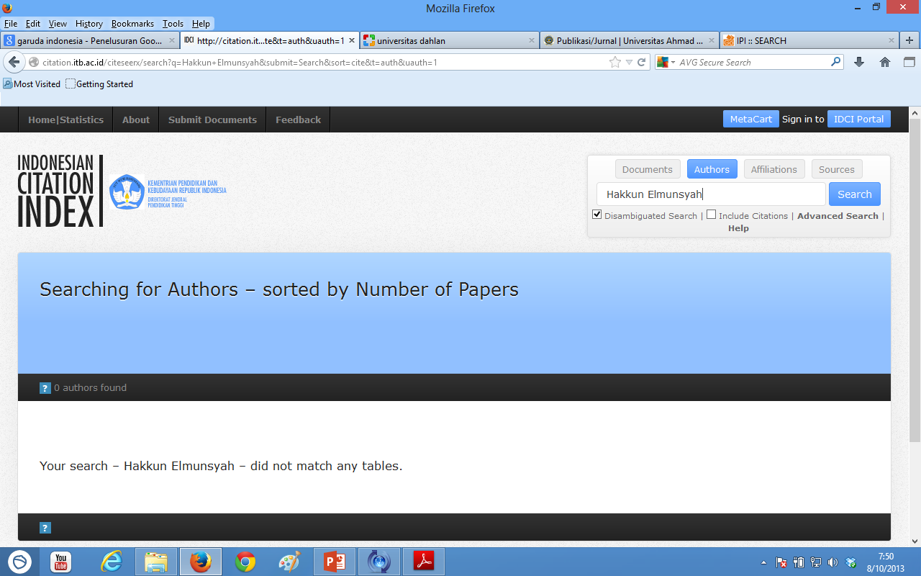
Contoh Hasil Pencarian di Situs Pengindex

Slide 6
Akreditasi Jurnal Nasional: Penyebarluasan
Pencantuman di Pengindeks Internasional Bereputasi

Slide 7
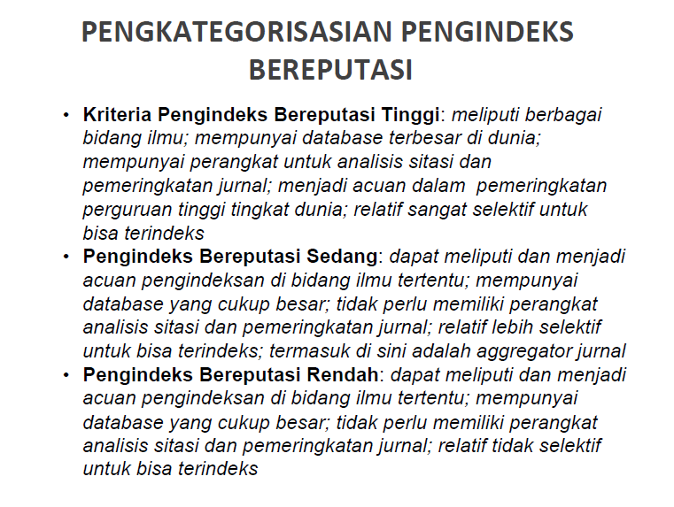

Slide 8
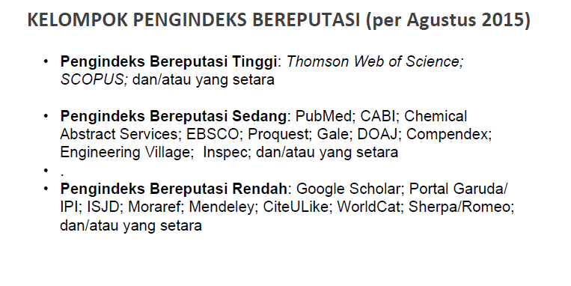

Slide 9
Langkah Yang Harus Ditempuh Penerbit untuk Keberhasilan Akreditasi Jurnal
No | Tahapan
1. | Menggunakan Aplikasi Jurnal Elektronik (e-Journal) sesuai standar penerbitan jurnal seperti OJS
2 | Melengkapi, Kebijakan, Ruang Lingkup Jurnal dan Publication Ethics
3 | Memiliki nomor E-ISSN
4 | Melengkapi Back Issue (terbitan lama)
5 | Mencantumkan Alamat, Manajemen Pengelola Secara Lengkap
6 | Mencantumkan Editorial Board Beserta Identitasnya termasuk didalamnya Sitasi dari editor pengelola jurnal dalam bentuk H-indeks dan i-indeks
7 | Memasukkan pedoman penulisan dan templatenya serta penggunaan aplikasi referensi
8 | Menyediakan pedoman untuk editor, mitra bestari, penulis dan pembaca, secara singkat, padat dan mudah dimengerti
9 | Melengkapi setiap fitur yang ada, seperti statistik Akses, Hits/Jumlah kunjungan unik
11 | Mendaftarkan DOI ke cross reff, dan mengaplikasikan ke setiap artikel
12 | Mendaftarkan ke lembaga Pengindeks umum seperti ISJD, Google Schoolar, DOAJ, dan pengindeks khusus bidang, serta menampilkan lembaga yang sudah mengindeks dalam websitenya.
13 | Menjalankan bisnis proses secara on-line
14 | Menyiapkan profil google scholar untuk setiap jurnal

Slide 10

GOOGLE SCHOLAR
1

Slide 11
Indeksasi Jurnal di Google Scholar
Costless alias gratis
Mesin Google otomatis melakukan Crawl metadata secara kontinyu. Pengelola Jurnal tidak perlu mengupload manual
Dapat mendeteksi jumlah sitasi dan melihat artikel mana saja yang telah mensitasi.
Alamat Google Scholar: http://scholar.google.com
Alamat untuk registrasi: http://www.google.com/support/scholar/bin/request.py
http://support.google.com/scholar/bin/request.py?
profil jurnal dapat dibuat pada Google Scholar untuk menganalisis sitasi jurnal (updated otomatis)

Slide 12
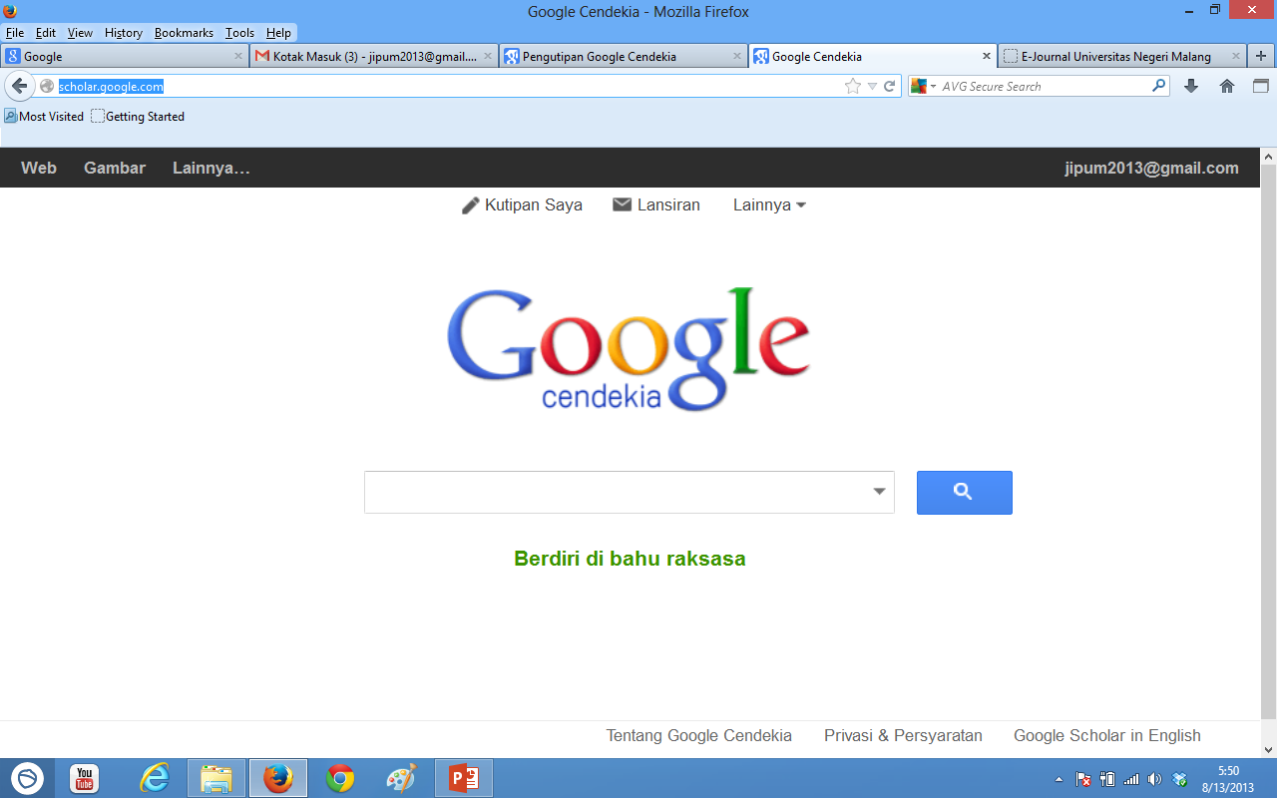
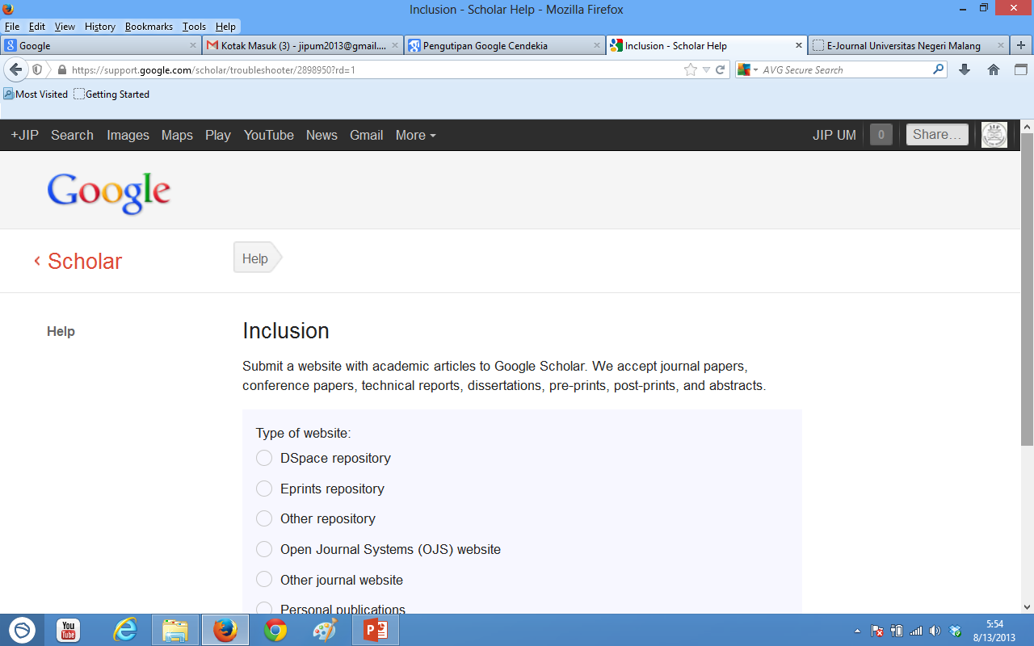
Indeksasi via Google Scholar
http://scholar.google.com/
Untuk melihat
Profil Jurnal
Melihat profil “myCitations” (menambah & kurangi artikel)
1. Membuat Profil di Scholar
Langkah awal
mengindeks Jurnal
https://support.google.com/scholar/bin/request.py
2. Pilih jenis portal website jurnal kita

Slide 13
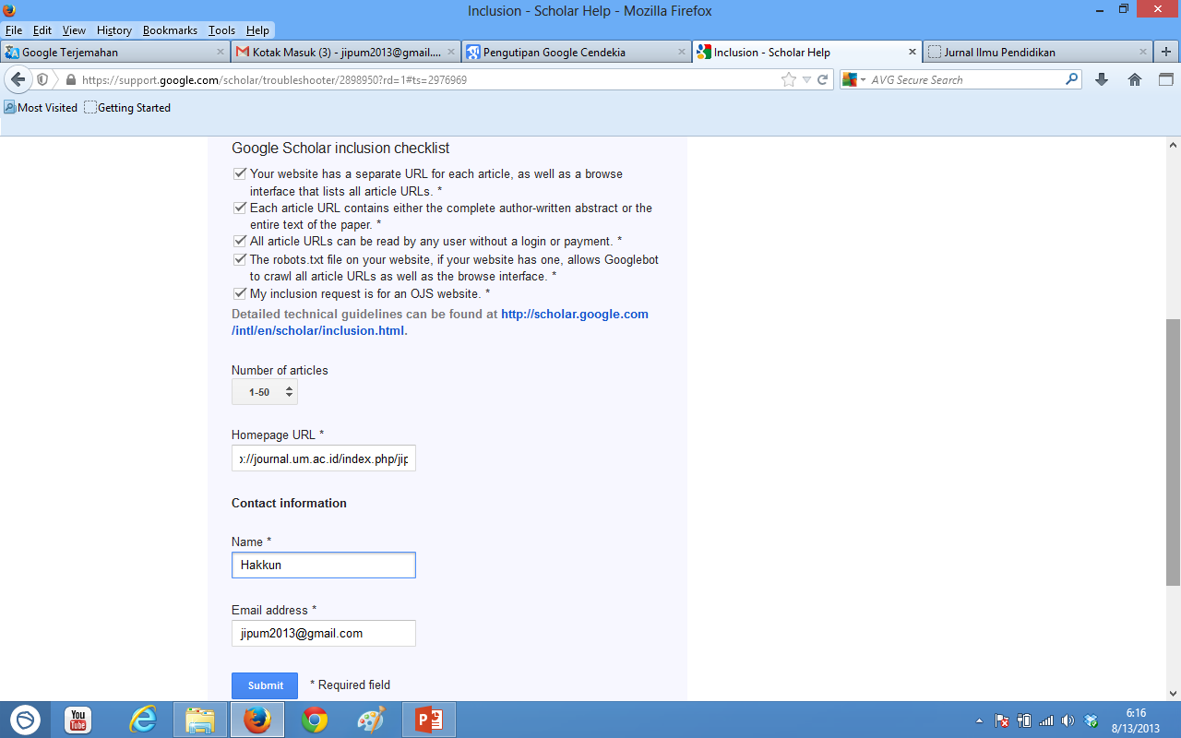
Pencantuman Artikel di WEB via Indeksasi google scholar
Masukkan alamat website Jurnal

Slide 14
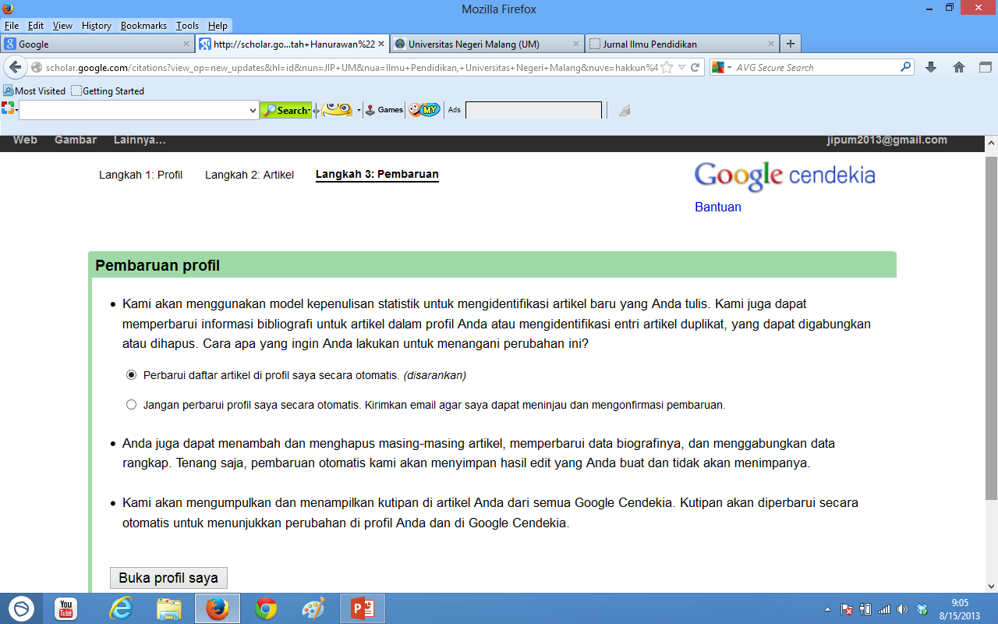
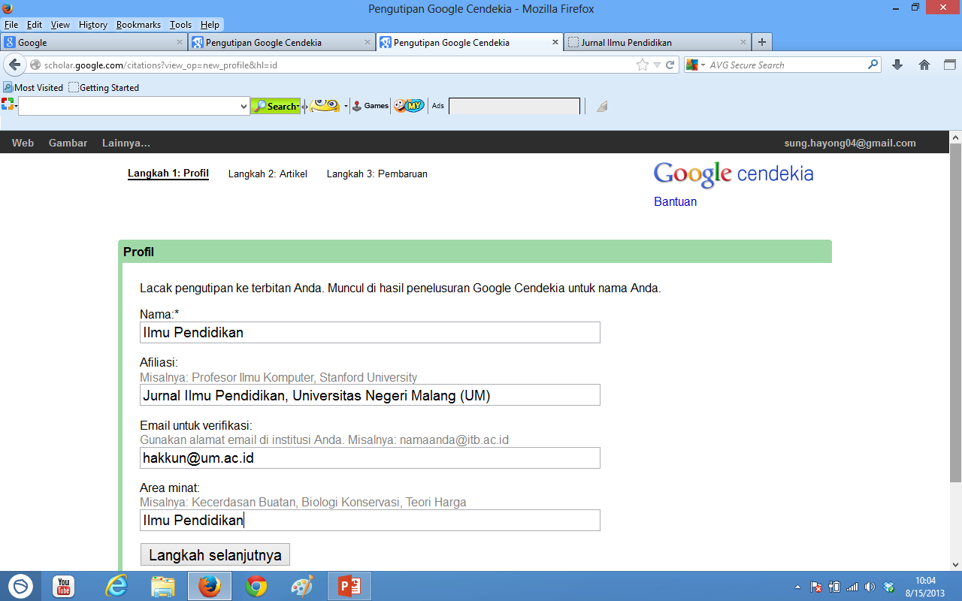

Slide 15
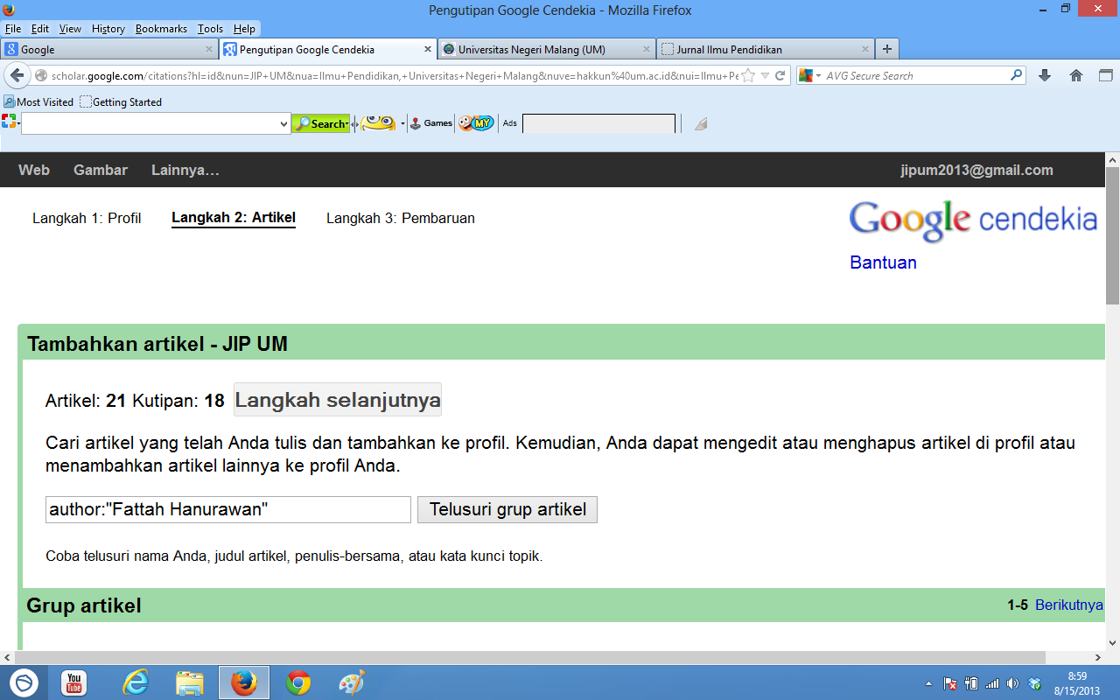

Slide 17
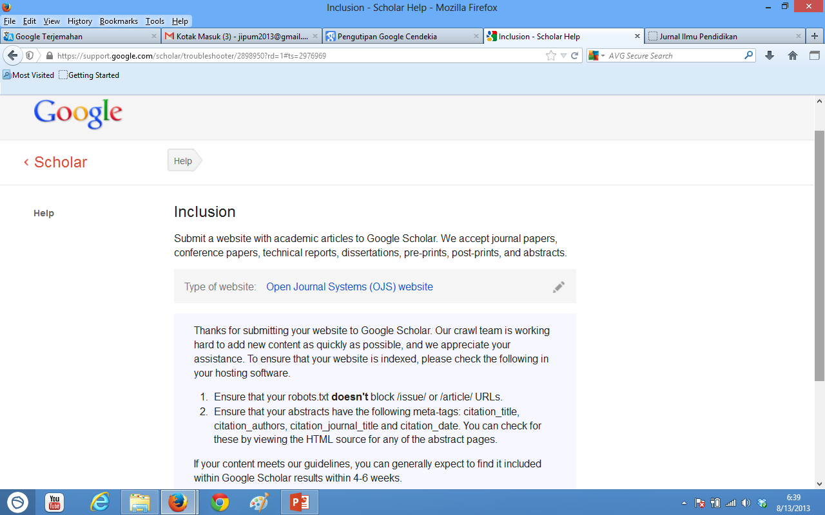
Finishing penyertaan artikel di web
CHECK html Source Abstrak Artikel (Firefox Browser)

Slide 18
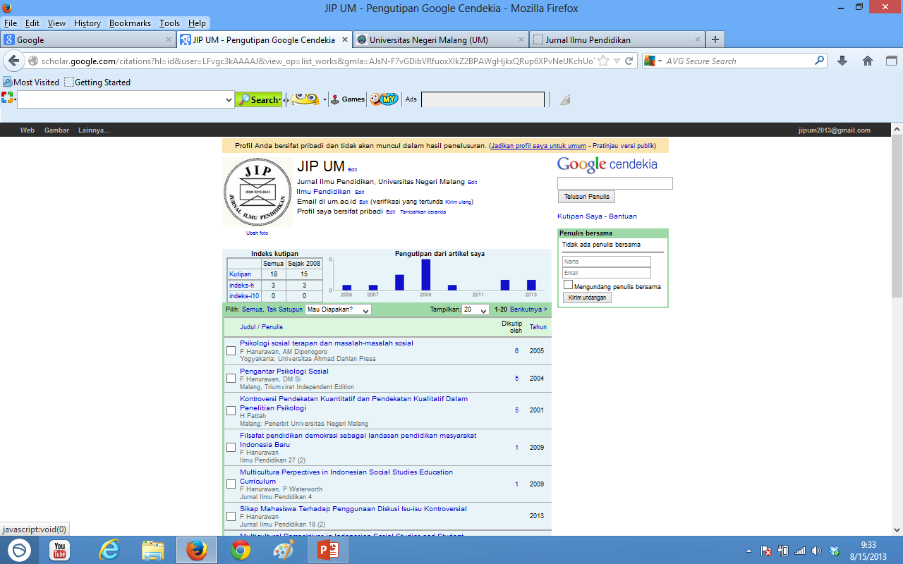
Jangan lupa di klik agar dapat di searching calon pensitasi

Slide 19
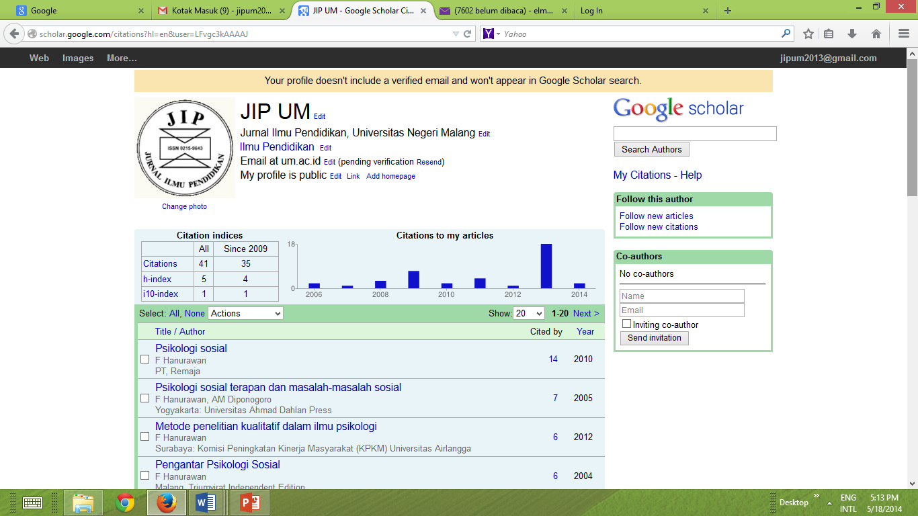
6 bulan kemudian

Slide 20
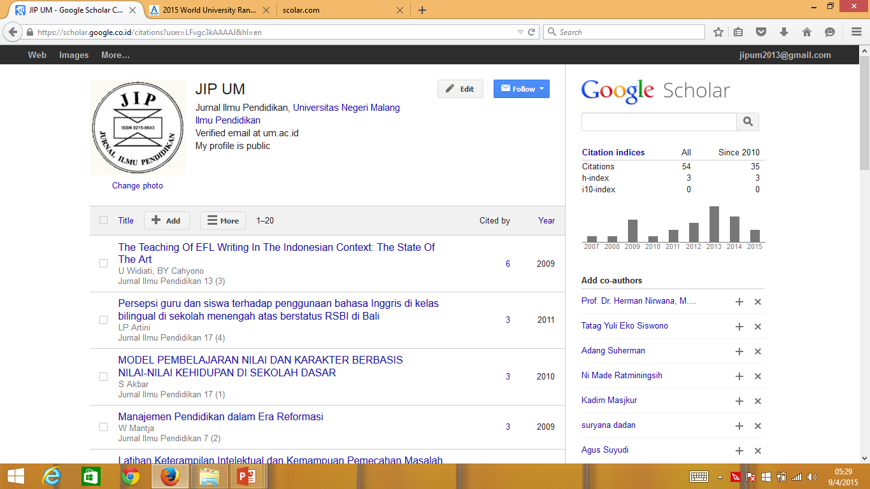
Beberapa jam yang lalu

Slide 21

2

Slide 22

What is DOAJ?
Sebuah database yang berisi daftar high quality, peer-reviewed, open access journals
A whitelist, not a blacklist
ALL disciplines & all languages
Sebuah hub untuk koleksi dan distribusi koleksi metadata ke pihak ke-3.
Dikembangkan dengan standar open-source software, Cottage Labs().
Tersedia gratis bagi siapa saja di seluruh dunia.

Slide 23
What is DOAJ aim?
Menjadi rujukan dalam pencarian open access journals/ articles.
Rujukan relevan bagi kurator di seluruh dunia.
Meningkatkan kualitas dan visibilitas open access journals
Melibatkan masyarakat untuk meningkatkan transparensi dan sharing informasi DOAJ

Slide 24
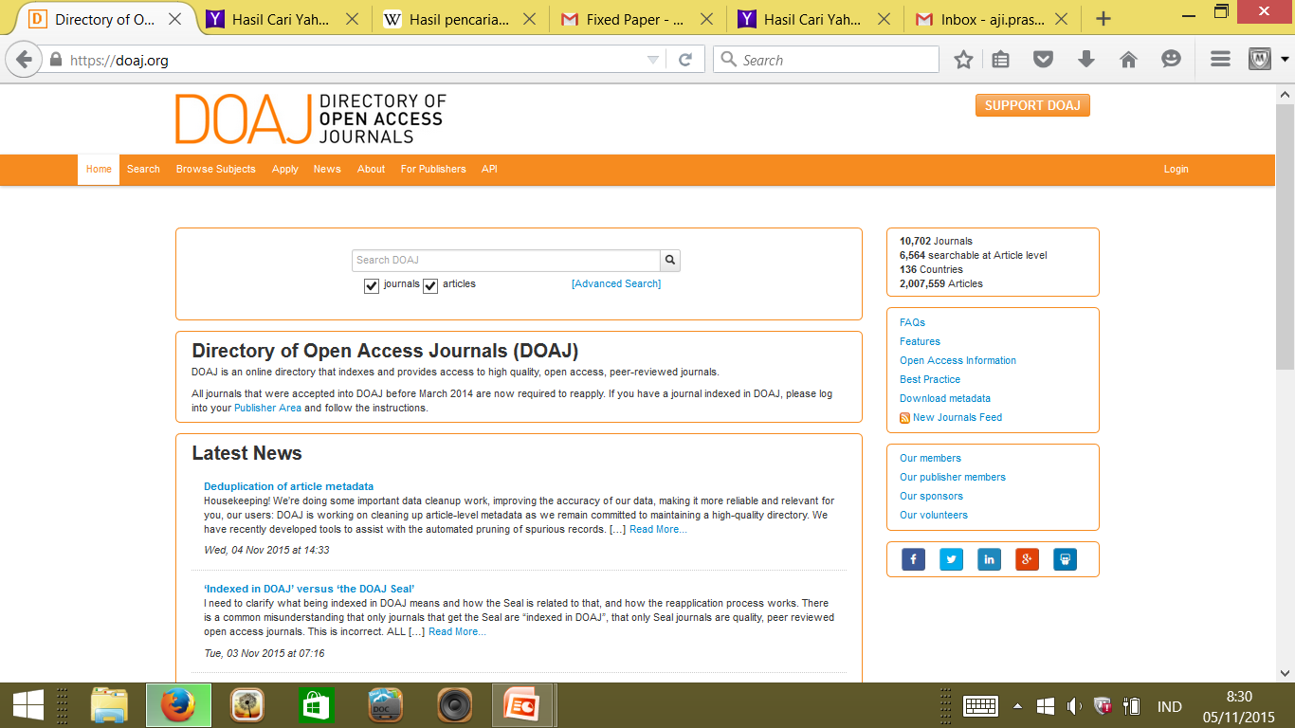
DOAJ Home?

Slide 25

Formulir pendaftaran baru
Sejak 2013, yang sudah terindeks menggunakan form lama harus mengisis ulang
Formulir lama: 6 soal | Baru: 58 soal
Setiap pertanyaan berfungsi sebagai indikator karakteristik sebuah jurnal.
This calls for volunteers: Arabic, Chinese, Farsi, Hungarian, Indonesian, Polish, Portuguese, Russian, Spanish, Turkish

Slide 26
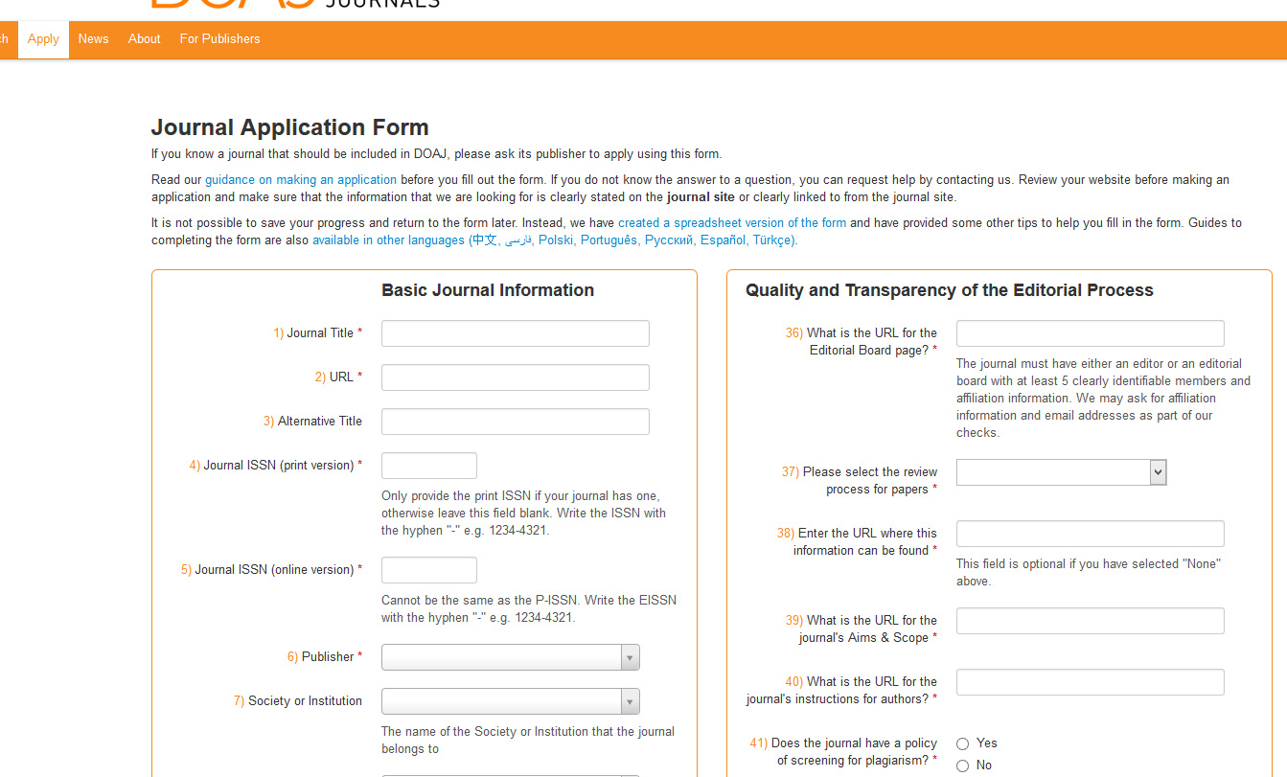
DOAJ's new application form

Slide 27
Isian Formulir Registrasi DOAJ
Basic Journal Information (1-35)
Quality and Transparency of the Editorial Board Process ( 36-43)
How Open is the Journal? (44)
Content Licensing (45-51)
Copyright and Permissions (52-55)
Information about You (56-58)

Slide 28
Basic Journal Information
1-35

Slide 29
Pertanyaan 1-6
Journal title
URL
Alternative title
Journal ISSN (print version)
Journal ISSN (online version)
Publisher
Nama sesuai issn
Alamat website jurnal
Singkatan nama jurnal
1234-1234
Pastikan berbeda dengan ISSN cetak
Nama intansi/organisasi penerbit

Slide 30
Pertanyaan 7-11
Society or Institution
Platform, Host or Aggregator
Name of Contact for this journal
Contact's email address
Confirm Contact's email address
Institusi terkait boleh kosong
Host (e.g. OJS) Agregator: EBSCO boleh kosong
Jurnal Manager/ E. In chief
Email no.9
Ulang no.10

Slide 31
Pertanyaan 12-16
In which country is the publisher of the journal based?
Does the journal have article processing charges (APCs)?
Enter the URL where this information can be found
Amount
Currency
Pilih negara penulis
Biaya publikasi yang dibebankan pada artikel yang diterima?
Cantumkan jika ada APC
Jumlahnya
Mata uang yang digunakan untuk APC

Slide 32
Pertanyaan 17-22
Does the journal have article submission charges?
Enter the URL where this information can be found
Amount
Currency
How many research and review articles did the journal publish in the last calendar year?
Enter the URL where this information can be found
Biaya mereview
Cantumkan jika ada biaya submissionnya
Jumlahnya
Mata uang yang digunakan untuk APC
Minimal 5 artikel/tahun
Munculkan laman tahun lalu

Slide 33
23-26
Does the journal have a waiver policy (for developing country authors etc)?
Enter the URL where this information can be found
What digital archiving policy does the journal use?
Enter the URL where this information can be found
Yes/No
Bukti no.23
Tidak boleh online arsip pribadi/universitas
Isi jika “No Policy in place”

Slide 34
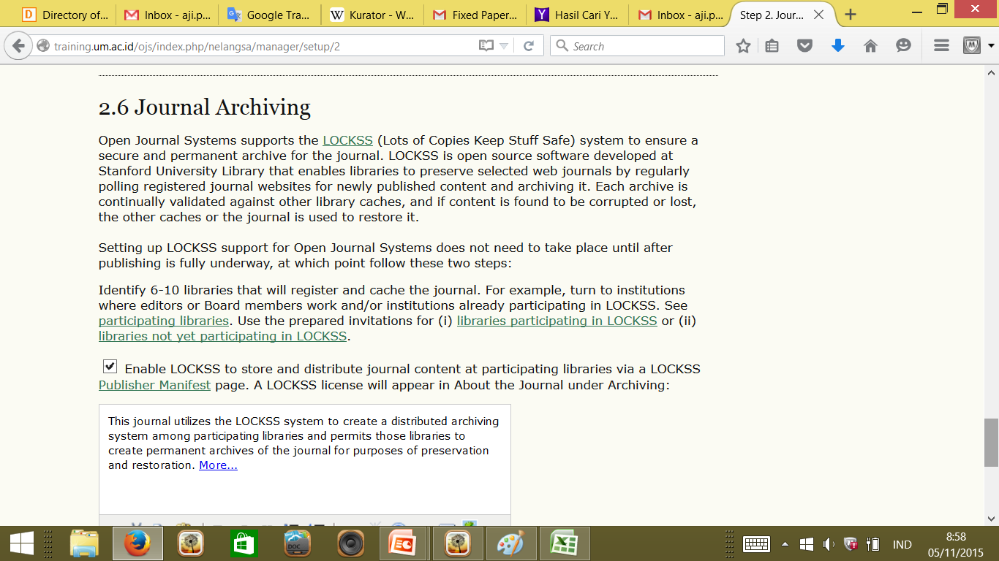
25.LOCKSS
Home > User > Journal Management > Journal Setup

Slide 35
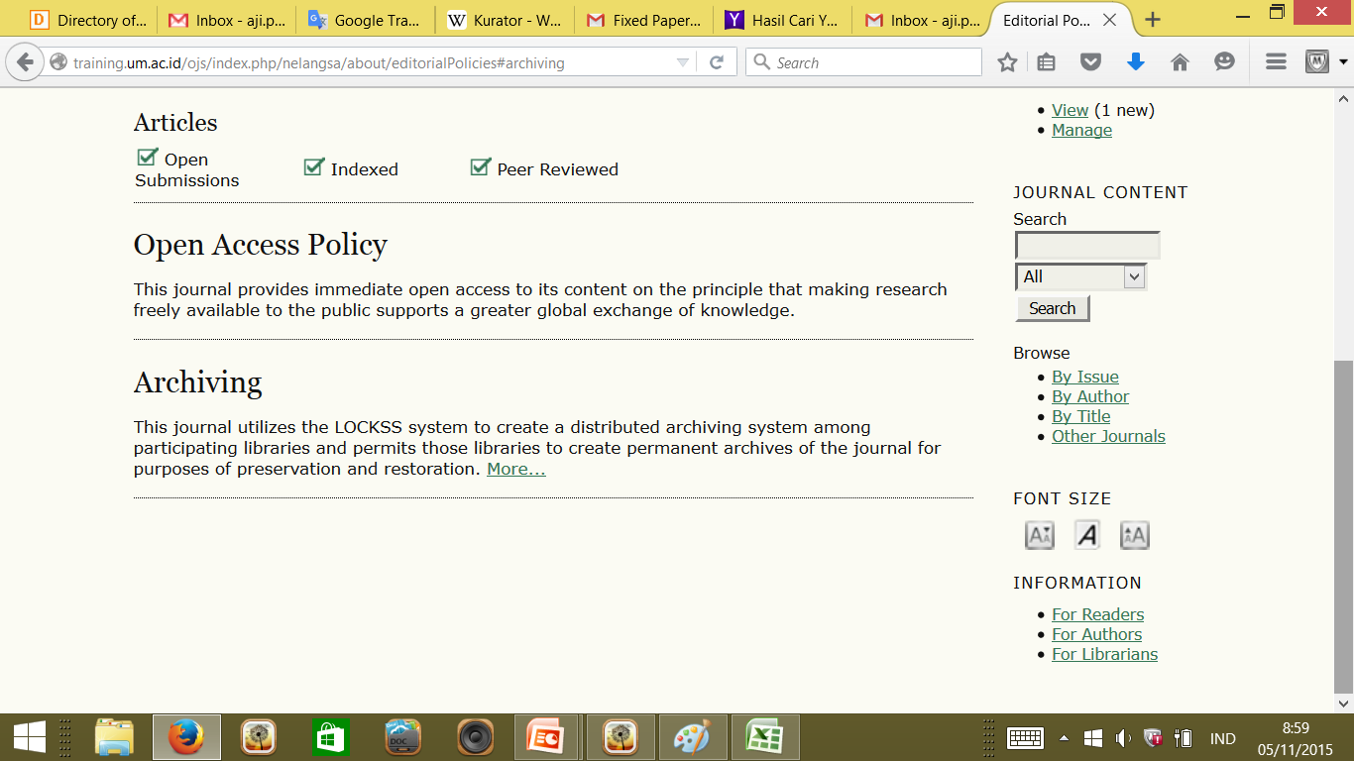
LOCKSS

Slide 36
27-29
Does the journal allow anyone to crawl the full-text of the journal?
Which article identifiers does the journal use?
Does the journal provide, or intend to provide, article level metadata to DOAJ?
Yes/No
None; DOI; Handles; ARK; Other
Yes: metadata harus dikirim ke DOAJ tidak lebih dari 3 bulan setelah terindeks

Slide 37
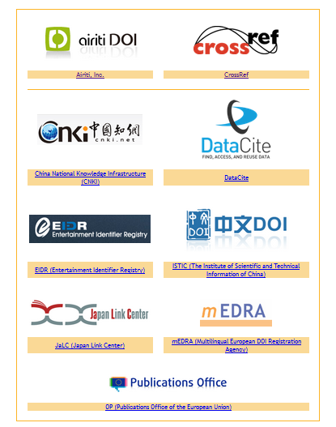
28.Mendapatkan DOI
Gunakan jasa DOI Registration Agency (RA)
Korespondensi dengan RA, misalnya: crossreff
http://crossref.org/01company/contactus.html

Slide 38
30-33
Does the journal provide article download statistics?
Enter the URL where this information can be found
What was the first calendar year in which a complete volume of the journal provided online Open Access content to the Full Text of all articles? (Full Text may be provided as PDFs. Does not apply for new journals.)
Please indicate which formats of full text are available
'No' lanjut no.32
Diisi jika 30 Yes
Tahun pertama fulltext
Pilih salah satu

Slide 39
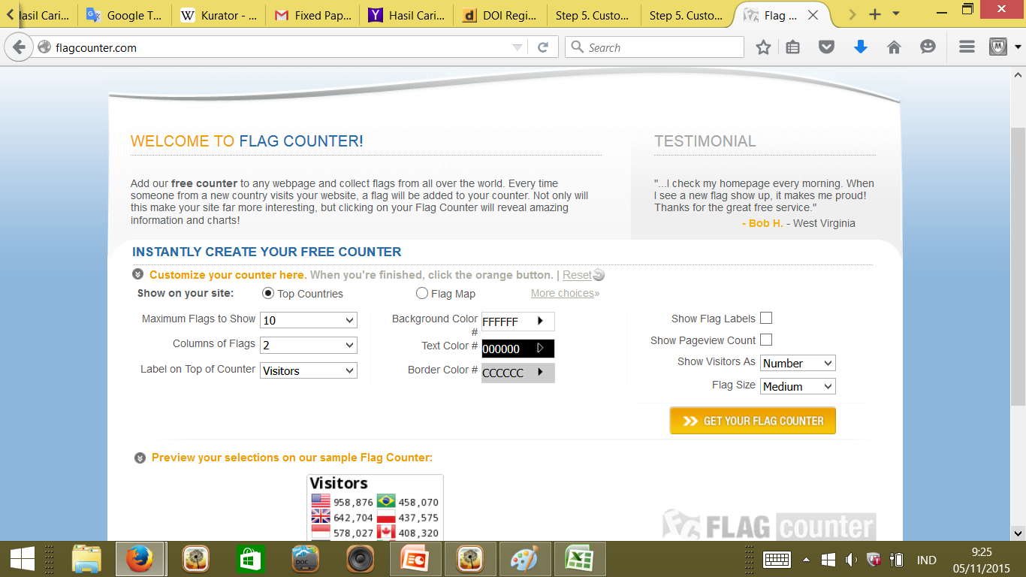
30. Menambahkan fitur statistik: Flagcounter

Slide 40
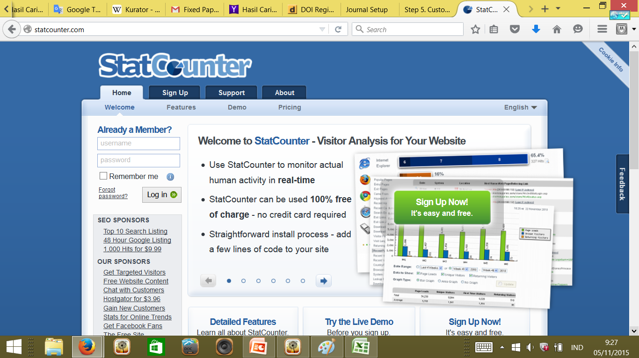
30.Menambahkan fitur statistik: Statcounter

Slide 41
Menambahkan fitur statistik:
Simpan HTML codenya
Masuk ke laman jurnal sebagai journal manager
Home > User > Journal Management > Journal Setup
The Look: Journal Page Footer>HTML source Editor
Tulis/ Paste HTML statistik yang telah disimpan

Slide 42
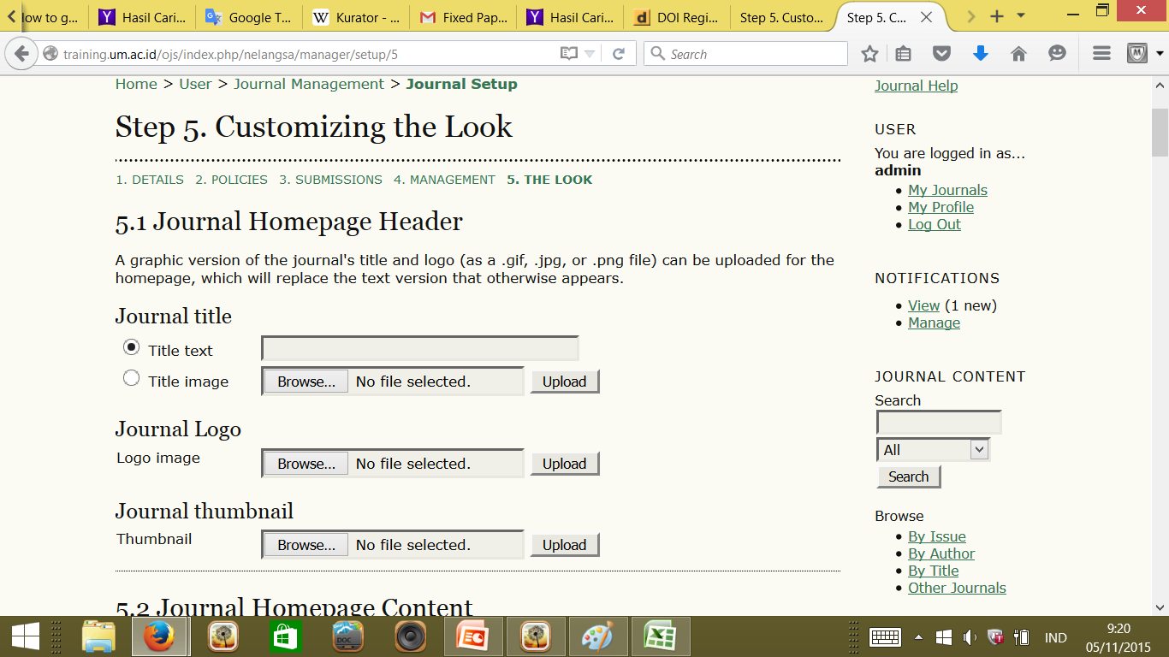

Slide 43
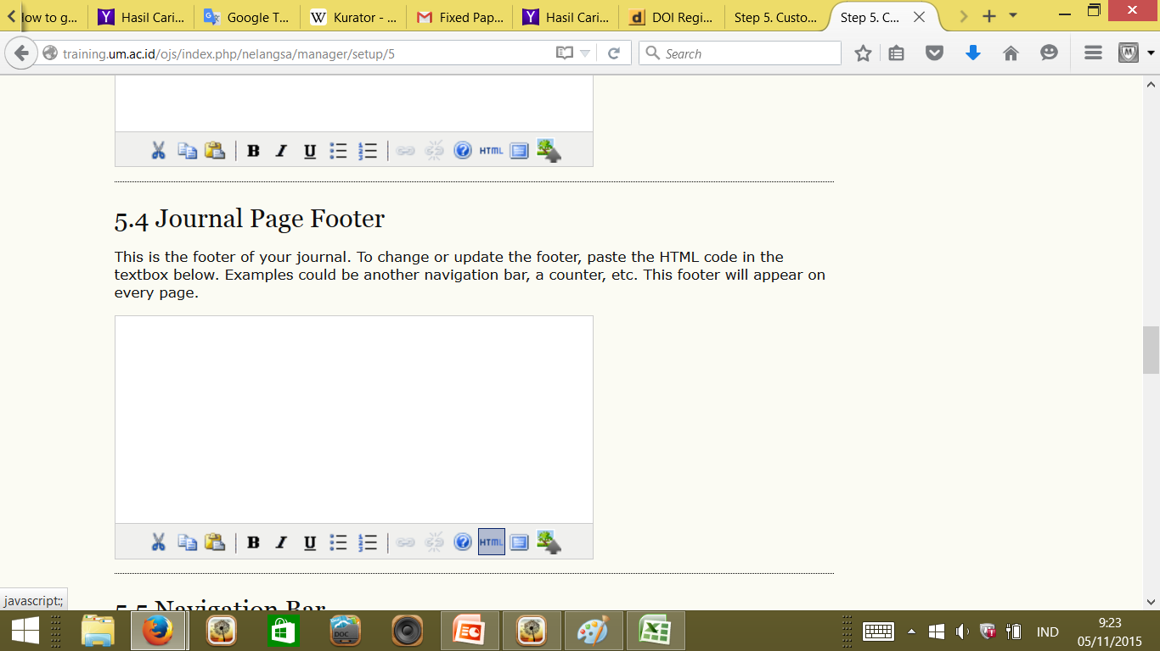

Slide 44
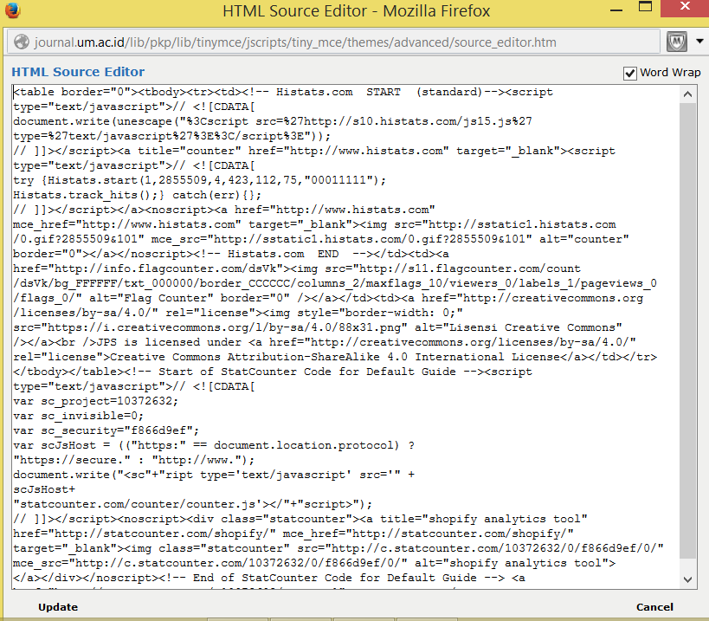
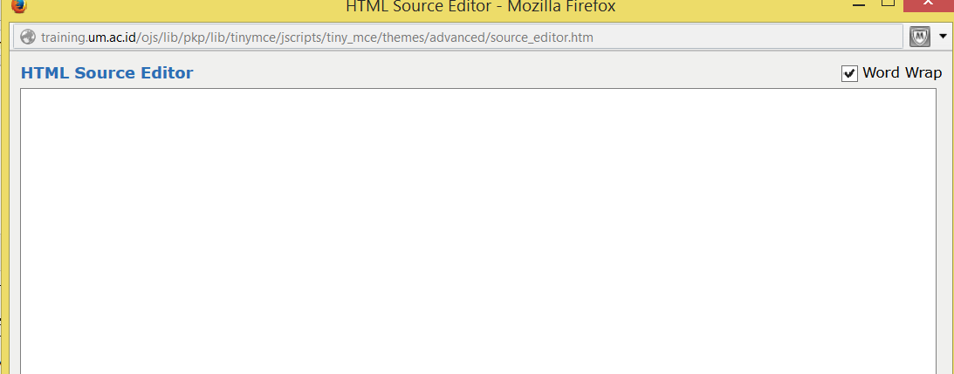

Slide 45
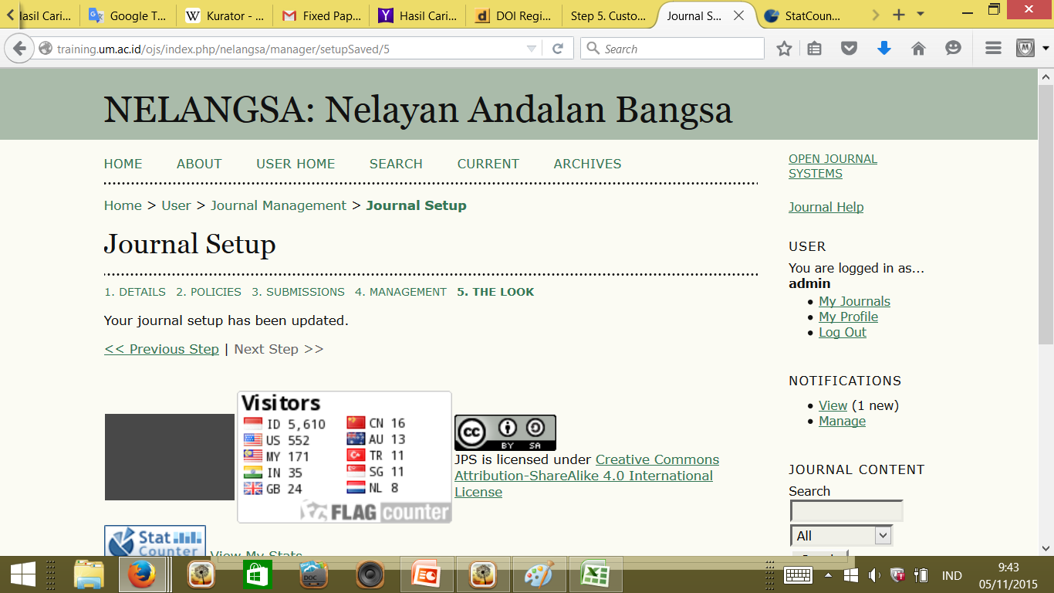

Slide 46
34-35
Add keyword(s) that best describe the journal
Select the language(s) that the Full Text of the articles is published in
Max 6 english keywords
bahasa pada artikel, bukan abstrak, 1 juranal bisa lebih dari 1 bahasa

Slide 47
Quality and Transparency of the Editorial Board Process
36-43

Slide 48
36-40
What is the URL for the Editorial Board page?
Please select the review process for papers?
Enter the URL where this information can be found
What is the URL for the journal's Aims & Scope?
What is the URL for the journal's instructions for authors?
Harus ada, kecuali jurnal humanities (min 2 editor)
Pilih satu, 'Editorial review' hanya untuk jurnal humanities
Jika 37=“None”, tidak perlu diisi
Webpage jurnal
Webpage jurnal

Slide 49
41-43
Does the journal have a policy of screening for plagiarism?
Enter the URL where this information can be found
What is the average number of weeks between submission and publication?
Yes/No
Webpage screening plagiarism
angka

Slide 50
41: contoh plagiarism policy
Plagiarism Policy
PLAGIARISM INCLUDES BUT IS NOT LIMITED TO:
a. refer and/or quoting terms, words and/or sentences, data and/or information from a source without citing sources in the record citation and/or without stating the source adequately;
b. refer and/or quoting random terms, words and/or sentences, data and/or information from a source without citing a source in the record citation and/or without stating the source adequately;
c. using a source of ideas, opinions, views, or theory without stating the source adequately;
d. formulate the words and/or sentences themselves from the source of words and/or phrases, ideas, opinions, views, or theory without stating the source adequately;
e. submit a scientific papers produced and/or published by others as a source of scientific work without express adequately.
PREVENTION
In every article submitted to the Journal of Humanities Education must be attached to a statement signed by the author that:
a. The article is free of plagiarism;
b. if at a later proved there is plagiarism in the article, the author is willing to accept the sanctions in accordance with the legislation.
SANCTIONS
a. reprimand;
b. letter of warning;
c. revocation of the article;
d. cancellation of publication.
Letter of Statement of free Plagiarism can be downloaded at here

Slide 51
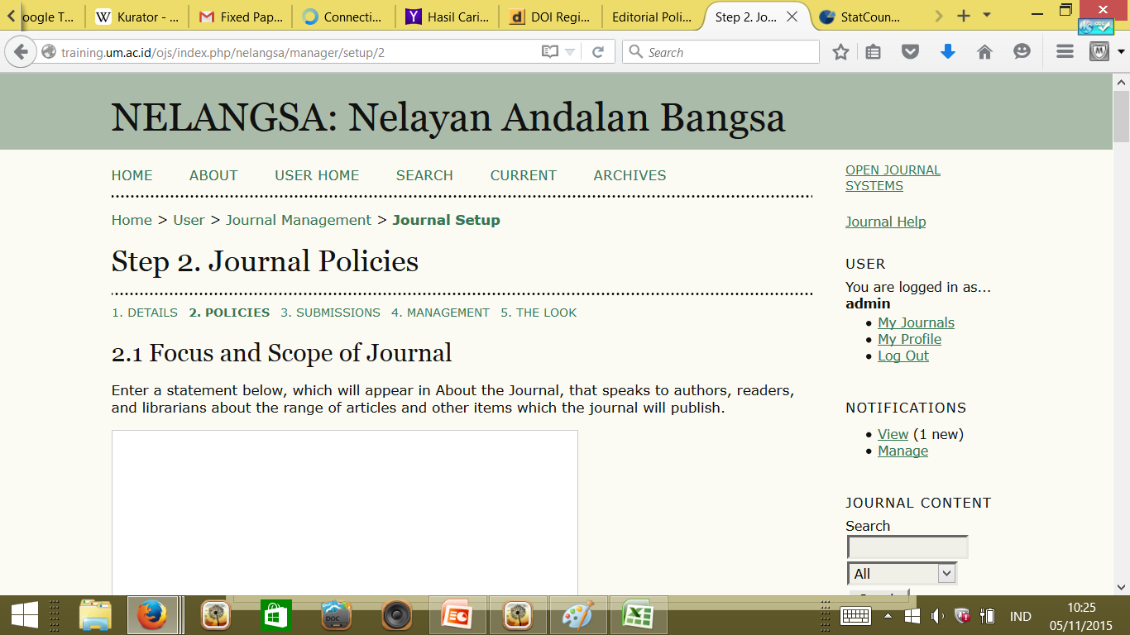
41:menambahkan plagiarism policy

Slide 52
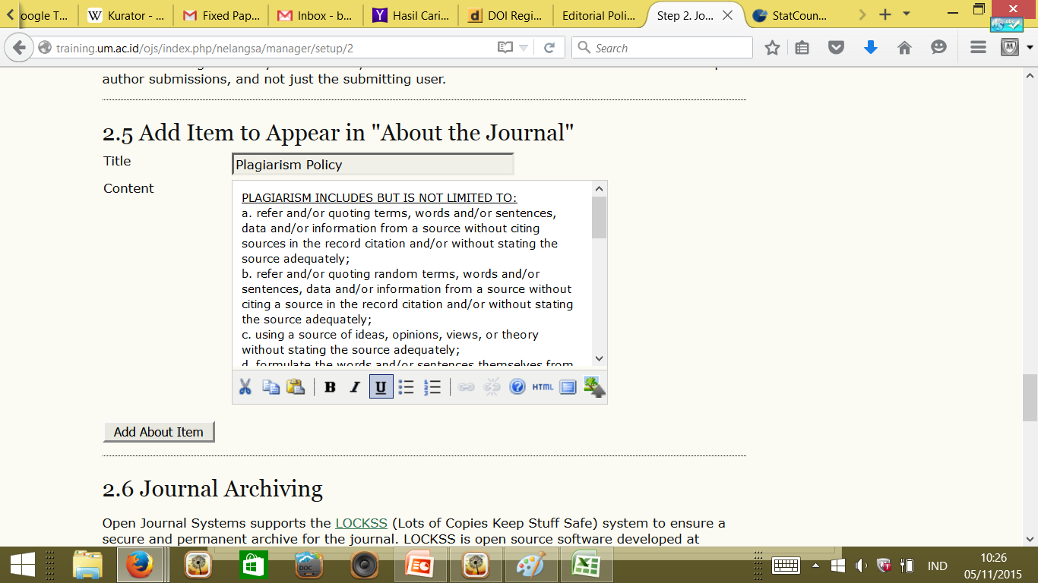

Slide 53
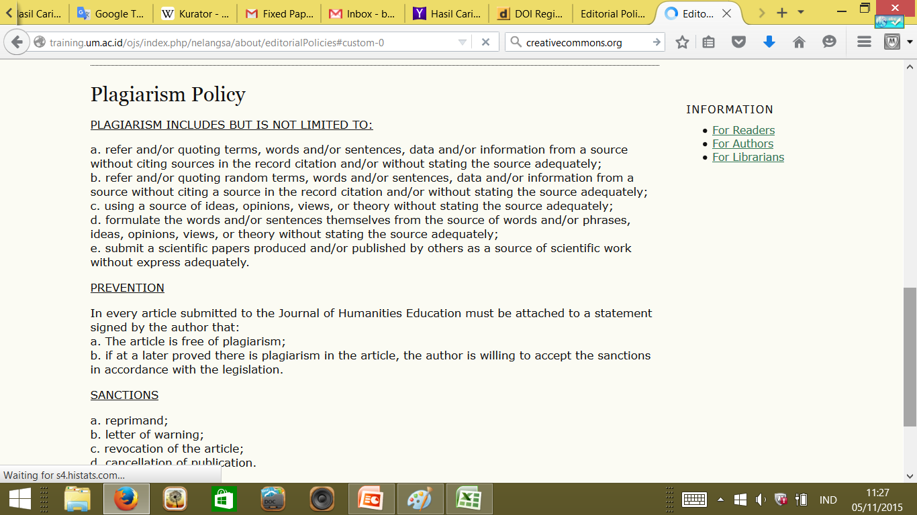
http://training.um.ac.id/ojs/index.php/nelangsa/about/editorialPolicies#custom-0

Slide 54
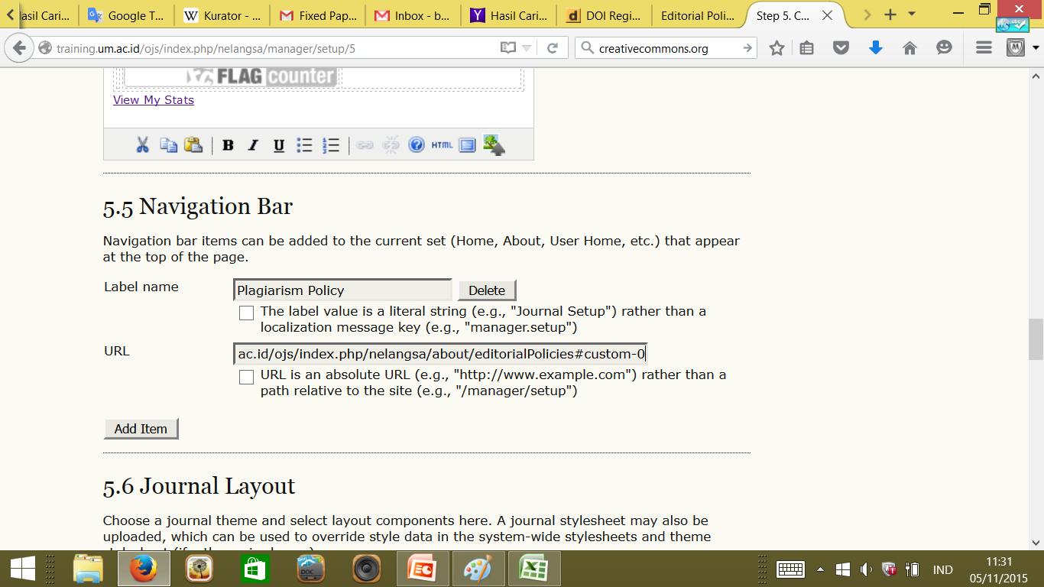

Slide 55
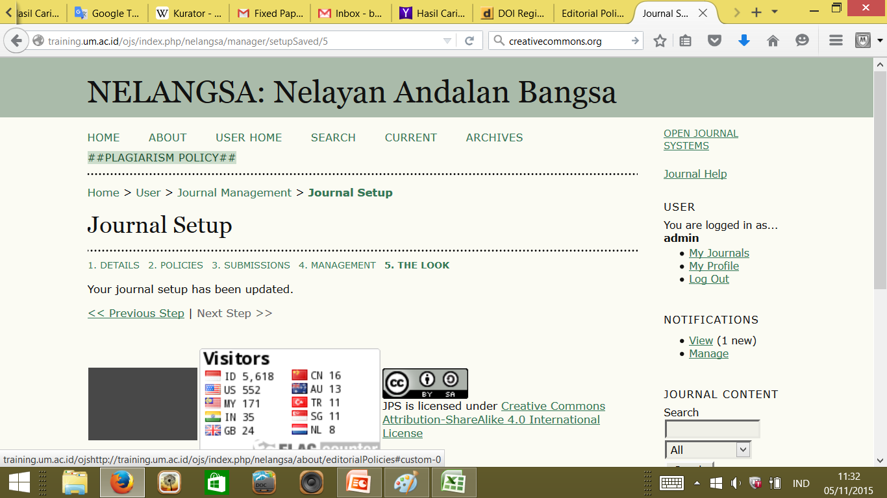

Slide 56
How Open is the Journal?
44

Slide 57
44
What is the URL for the journal's Open Access statement?
Home > About the Journal > Editorial Policies

Slide 58
Content Licensing
45-51

Slide 59
45
Does the journal embed machine-readable CC licensing information in its article metadata?
Please provide a URL to an example page with embedded licensing information
Does the journal allow reuse and remixing of its content, in accordance with a CC license?
Which of the following does the content require? (Tick all that apply.)
Enter the URL on your site where your license terms are stated
Pilih di Creativecommons.org
Webpage jurnal
Sesuaikan dengan lisensi yang dipilih
47=other
Webpage jurnal

Slide 60
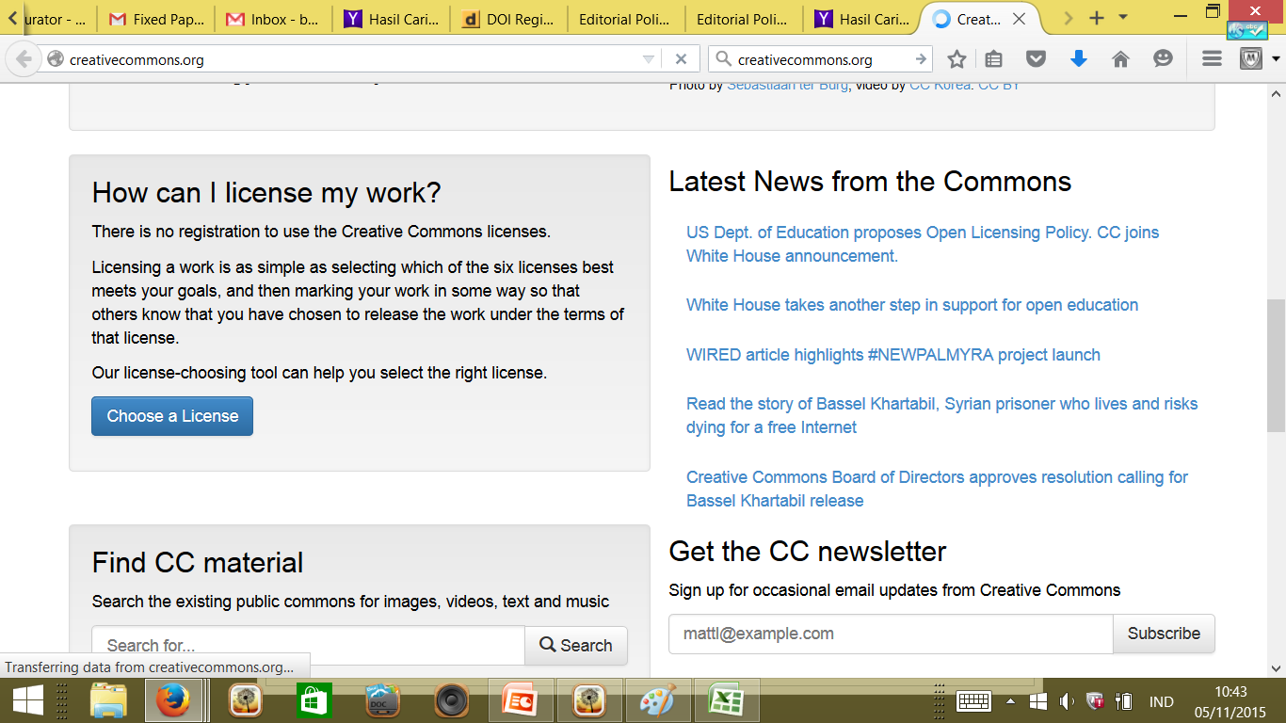
45.Mendapatkan CClicensing

Slide 61
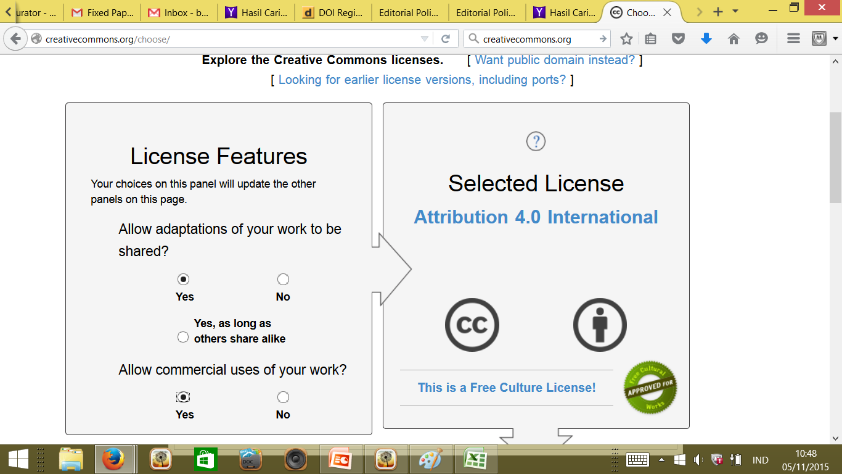

Slide 62
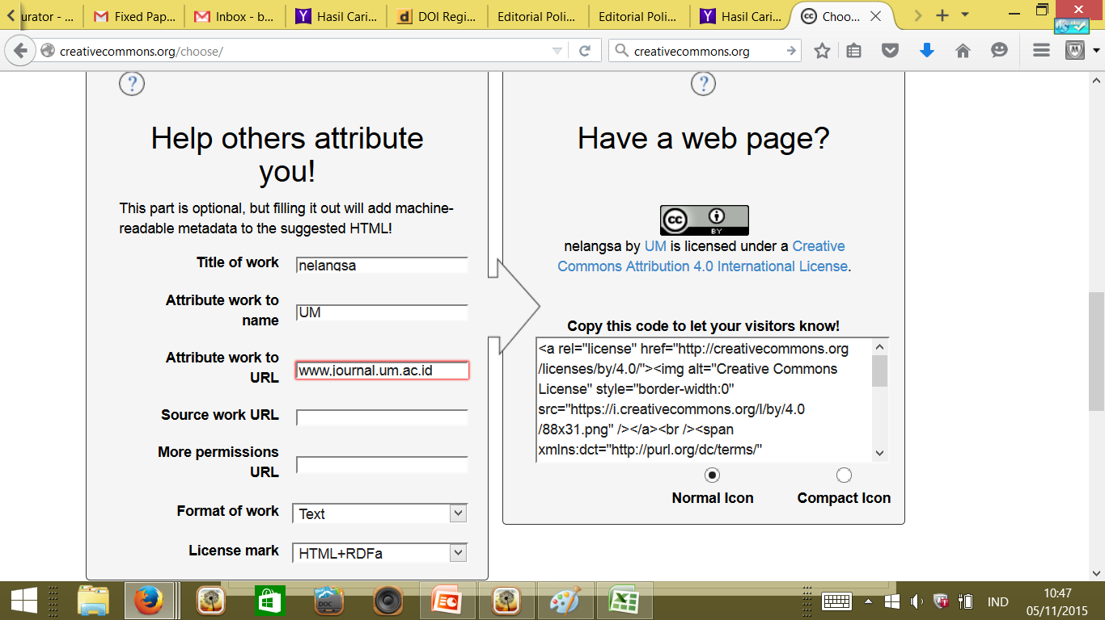

Slide 63
45. Menambahkan CCLicensing ke web jurnal
Sama dengan menambah fitur statistik

Slide 64
50-51
Does the journal allow readers to 'read, download, copy, distribute, print, search, or link to the full texts' of its articles?
With which deposit policy directory does the journal have a registered deposit policy?
Yes/No
Sherpa/Romeo: http://www.sherpa.ac.uk/romeo/; Héloïse; Diadorim;.

Slide 65
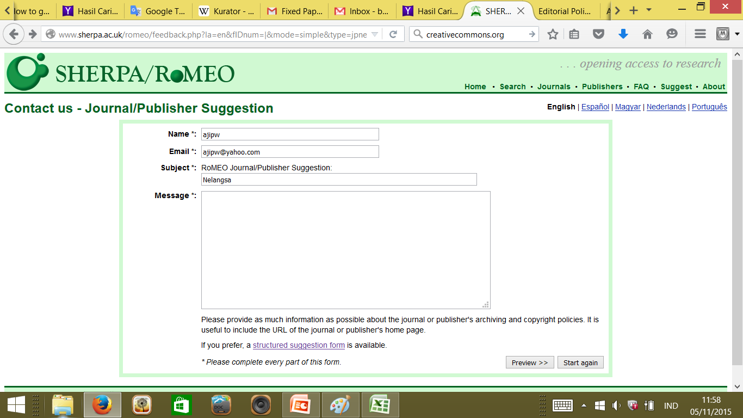
51.Sherpa/Romeo

Slide 66
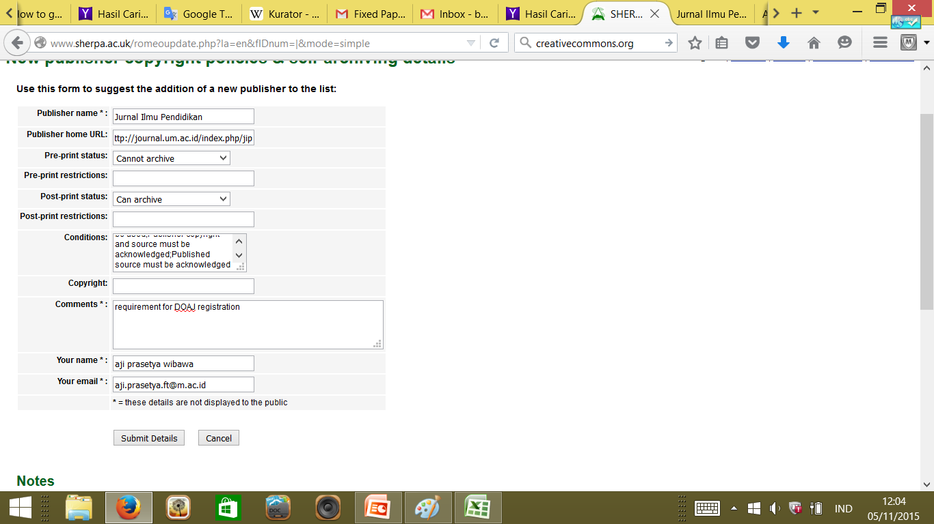

Slide 67
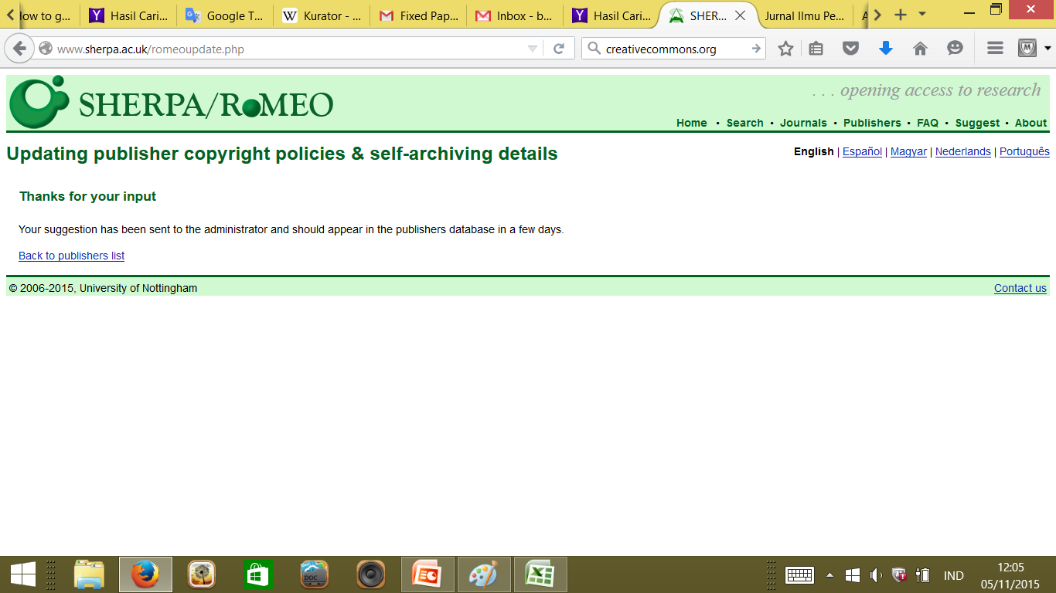

Slide 68
Copyright and Permissions
52-55

Slide 69
52-55
Does the journal allow the author(s) to hold the copyright without restrictions?
Enter the URL where this information can be found
Will the journal allow the author(s) to retain publishing rights without restrictions?
Enter the URL where this information can be found
Yes/No
52 yes
Yes/No
54 yes

Slide 70
Information about You
56-58

Slide 71
56-58
Your name
Your email address
Confirm your email address
56-58 Identitas pengusul

Slide 72
DOAJ seal
to qualify for the Seal the journal must:
have an archival arrangement in place with an external party (Question 25). 'No policy in place' does not qualify for the Seal.
provide permanent identifiers in the papers published (Question 28). 'None' does not qualify for the Seal.
provide article level metadata to DOAJ (Question 29). 'No' or failure to provide metadata within 3 months do not qualify for the Seal.
embed machine-readable CC licensing information in article level metadata (Question 45). 'No' does not qualify for the Seal.
allow reuse and remixing of content in accordance with a CC BY, CC BY-SA or CC BY-NC license (Question 47). If CC BY-ND, CC BY-NC-ND, 'No' or 'Other' is selected the journal will not qualify for the Seal.
have a deposit policy registered in a deposit policy directory. (Question 51) 'No' does not qualify for the Seal.
allow the author to hold the copyright without restrictions. (Question 52) 'No' does not qualify for the Seal.

Slide 73
Scopus
3

Slide 74
Content Selection for SciVersa Scopus
Newly suggested titles will be reviewed by the independent and international Scopus Content Selection & Advisory Board (CSAB) on a continuous basis. Before suggesting a title for Scopus coverage, it is recommended to read the statement of the CSAB about Advice to Secure Accession for a Journal to Scopus
Minimum Criteria
To be considered for review, titles should at least meet the following main eligibility criteria:
The title should have peer reviewed content
The title should be published on a regular basis (have a ISSN number that has been registered with the International ISSN Centre)
The content should be relevant and readable for an international audience (for example have English language abstracts and references in Roman script)
The title should have a publication ethics and publication malpractice statement

Slide 75
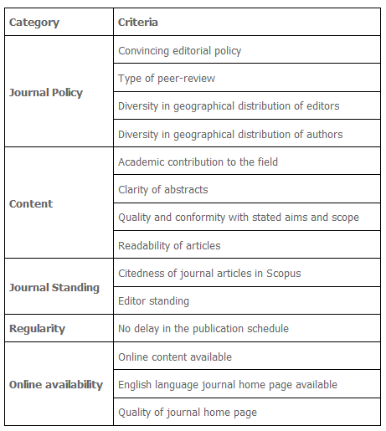
SCOPUS selection criteria
Subject experts review titles using both quantitative and qualitative measures and the selection is partly based on sample documents from the title. The criteria that will be used in the review process are grouped in five main categories: Journal Policy, Content, Journal Standing, Regularity and Online Availability.
After review, the suggestor and/or Publisher will be informed about the outcome of the review including the supporting reasons of the decision.

Slide 76
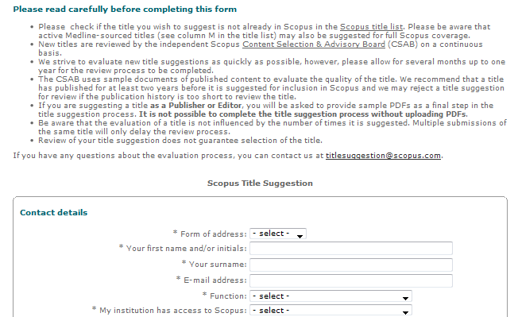
How to suggest to SCOPUS
http://suggestor.step.scopus.com/suggestTitle.cfm

Slide 77
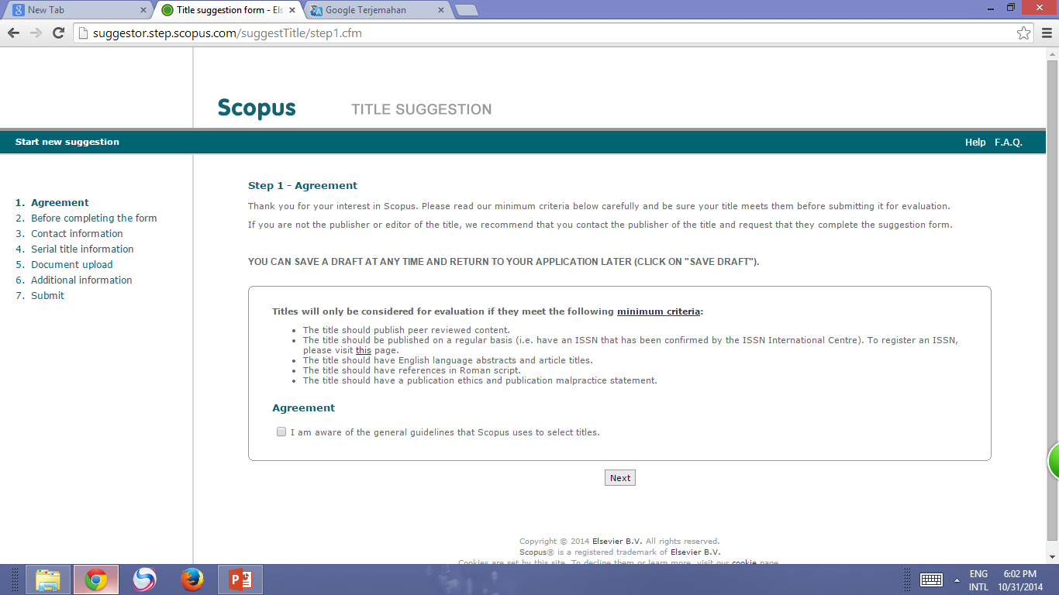

Slide 78
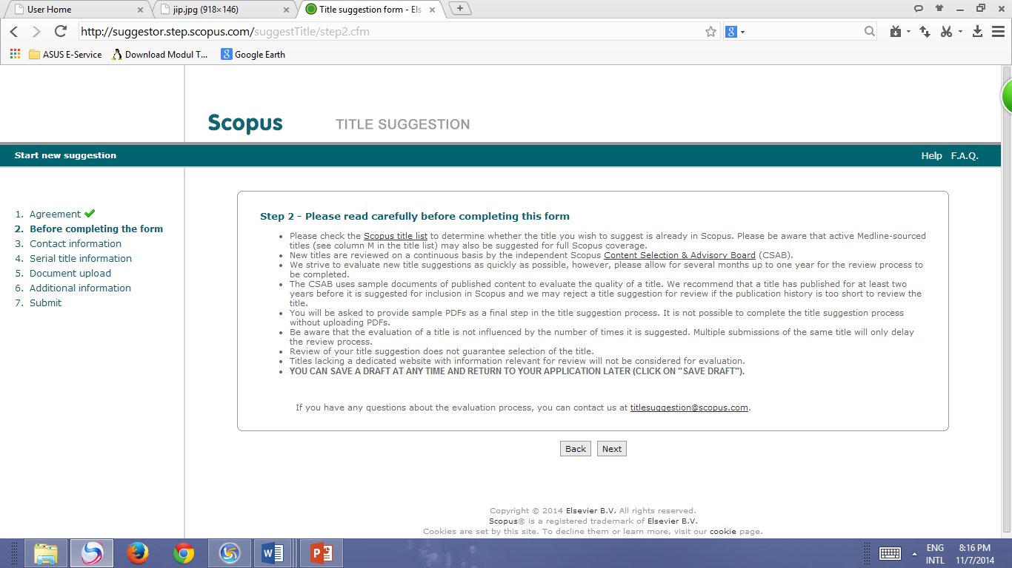

Slide 79
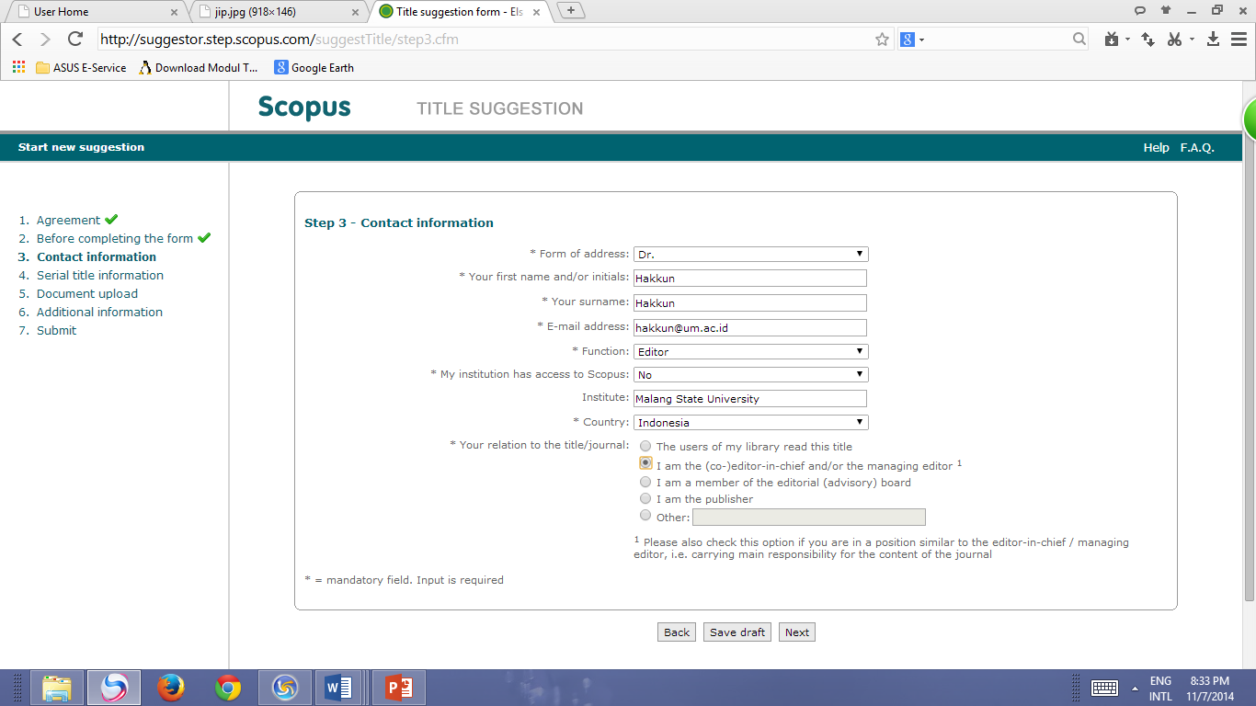

Slide 80
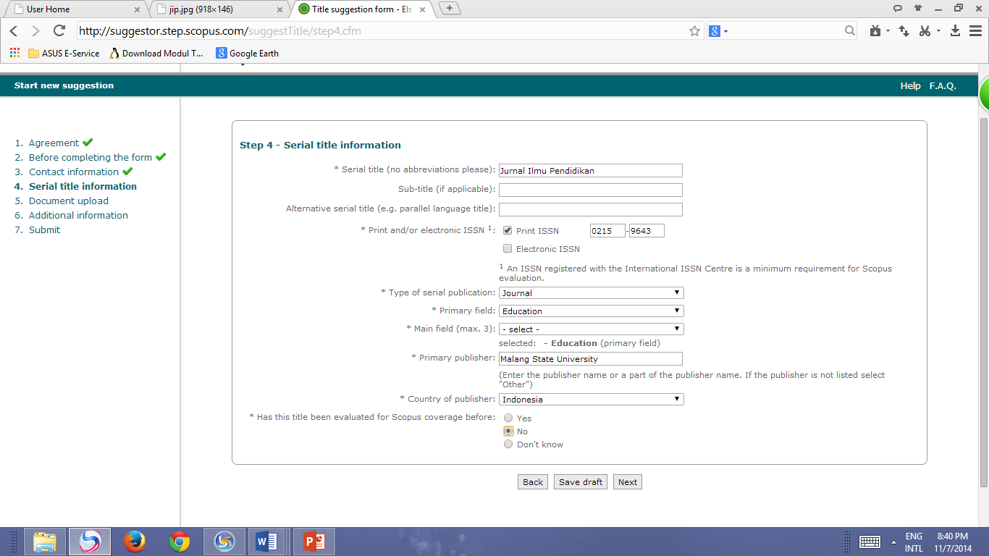

Slide 81
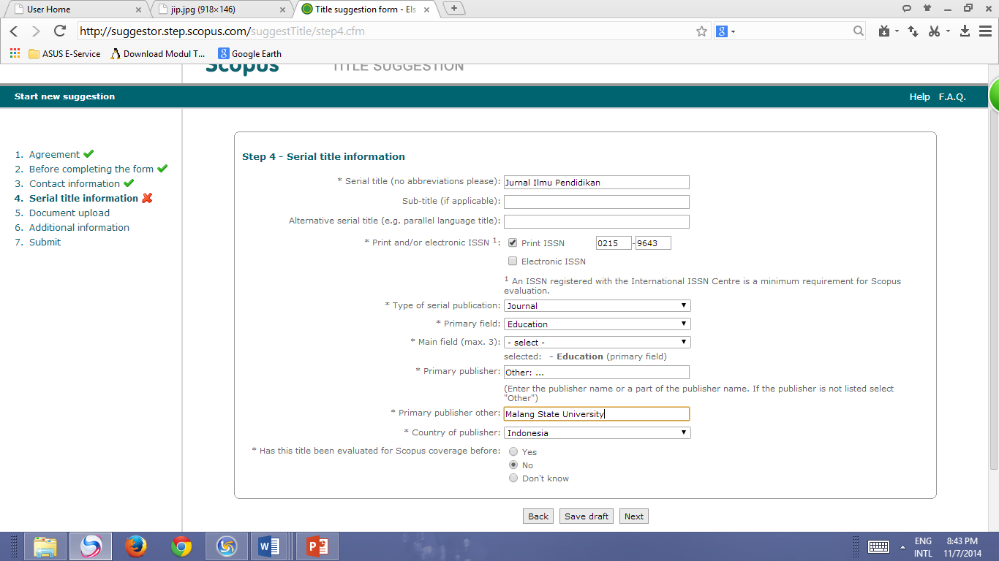

Slide 82
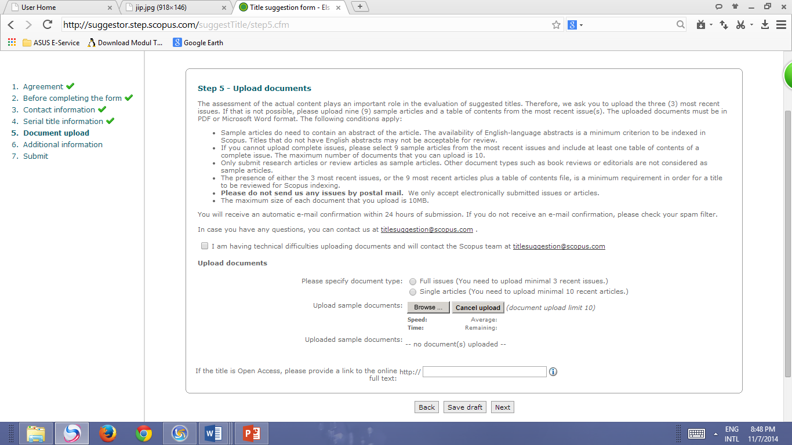

Slide 83
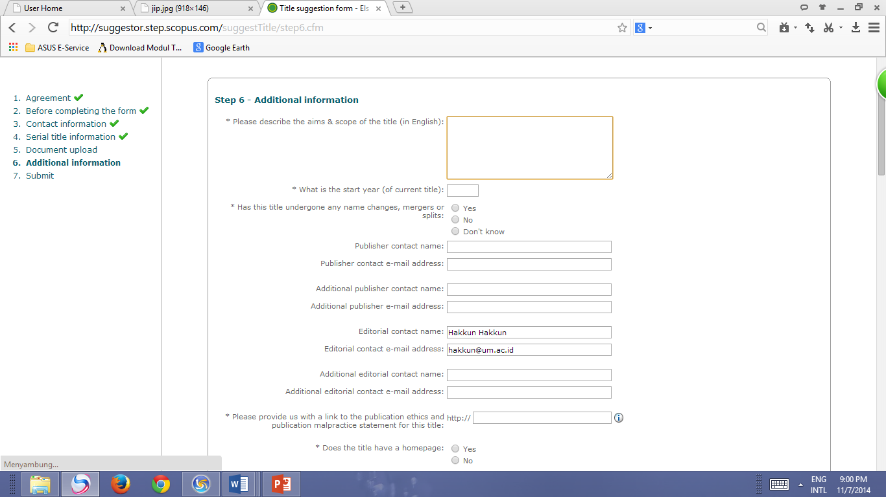

Slide 84
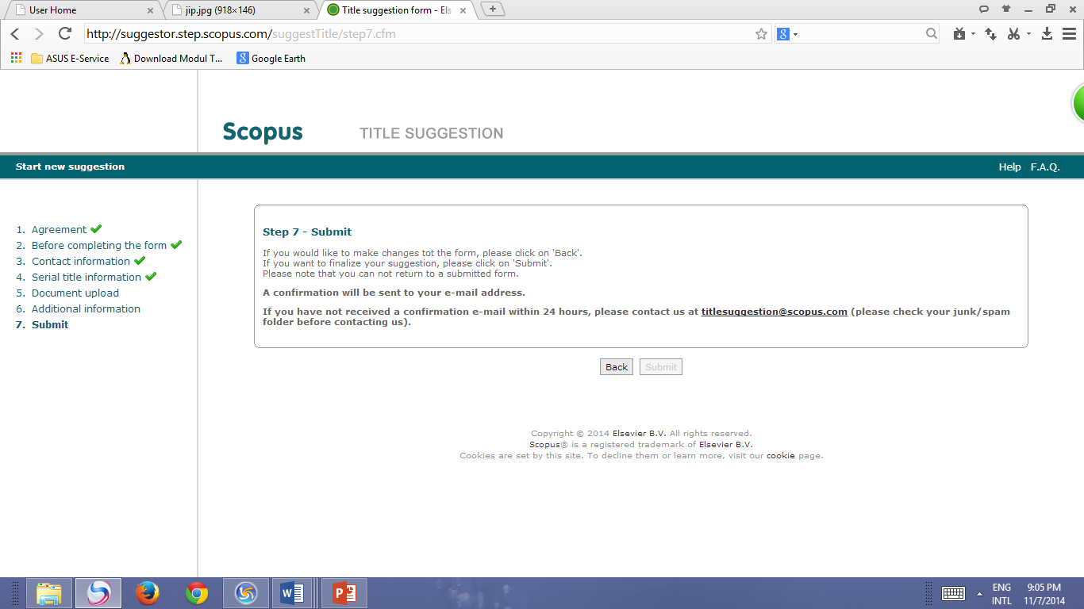

Slide 85


